Slide 1
Vaginal Discharge

Slide 2
Vagina
Fibromuscular tube communicating uterine cavity with the exterior by the intriotus at the vulva
Lined by stratified squamous epithelium without any secreting glands, consisting 4 layers
Superficial, intermediate, parabasal and basal layer
Is under the influence of estrogen and progesterone

Slide 3
Components of vaginal secretion
Secretion from the sweat and sebaceous glands of vulva and the bartholin gland
The transudate of the vaginal epithelium and the desquamated cells
The mucus secretion of the endocervical glands
The endometrial glandular secretion
Secretion from fallopian tubes

Slide 4
Flora of the female genital tract
In healthy female
Fallopian tubes, uterine cavity and cervical canal are free from organism
Doderlein bacilli is the only organism found in upper 2/3rd of the vagina
Large gram +ve sugar fermenting bacteria and normal habitant of vagina

Slide 5
Vaginal pH -
Mature vaginal squamous cells produce glycogen under the influence of estrogen
Glycogen is liberated in the process of continuous break down of these cells
Glycogen is converted into glucose and lactic acid by the Doderlein bacilli and maintains acid vaginal pH
Normal vaginal pH 4.5-5.5

Slide 6
Natural defense mechanism of the vagina
Tough stratified squamous epithelium, no glands
No crypts as in endocervix, so organism cannot remain in the crypts
Low pH unfavorable for bacterial growth
Defense mech is low during mens when pH is alkaline due to blood, cervical and endometrial discharge, after abortion and labor,
Excessive cervical discharge in endocervicitis

Slide 7
Physiological increase in vaginal discharge
Increased vaginal secretions occur normally at puberty (↑ vascularity), premenstrual phase (↑ secretions from endometrial glands, ↑ vascularity)
At the time of ovulation
Pregnancy(↑ vascularity)/puerperium
At the time of sexual excitement
Conditions causing pelvic congestion

Slide 8
Leucorrhea
Normal vaginal secretion in increased amount
No excess leucocytes
Microscopically and macroscopically nonpurulent
Cervical conditions- chronic cervicitis, ectropion (everted cx) erosion (columnar cells in the ectocervix)
Vaginal – pelvic congestion

Slide 9
Abnormal vaginal discharge
Excessive vaginal discharge – needs wearing of extra absorbent pads, clothes, tampons, diaper
Associated with other symptoms or signs eg blood stain, yellow colored, pus like and foul smelling
Itching, excoriations and ulcerations in vulva
pain abdomen, fever, urinary symptoms

Slide 10
Evaluation of Vaginal Discharge
Pathological or physiological ?
History- amount, onset, color, odor, consistency
Clinical examination – complete inspection and examination of external genitalia, speculum examination to inspect vaginal walls, posterior fornix, cervix and nature of discharge
swab coleection from the posterior fornix for c/s, hanging drop preparation, saline examination
endocervix, urethral swab if gonorrhea suspected

Slide 11
Vaginitis
Specific
Non specific

Slide 12
Specific causes of vaginitis
Trichomonas infection
Candida infection
Bacterial vaginosis

Slide 13
Trichomonas vaginalis
Very common
Common in women of child bearing age
Sexually transmitted
Sometimes by using infected towel, clothes
Favored by lowered general resistance and alkaline vaginal pH 5-6 (during period)

Slide 14
Contd…
Actively motile protozoa, slightly larger than a leucocyte and anaerobic
3 types- buccalis (mouth), hominis (anal canal and rectum), vaginalis (vagina)
Buccalis and hominis are unable to survive in the human vagina
Men harbour Tr vaginalis in prostate and urethra

Slide 15
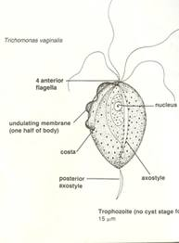

Slide 16
Symptoms and signs
Increased discharge with itching
Burning urination, dysuria, frequency
Inflammation of vulva, excoriations
Profuse vaginal discharge, thin, creamy or slightly green, frothy and irritating
Vaginal walls are tender
Multiple small punctate strawberry spots on the vaginal vault and the cervix

Slide 17
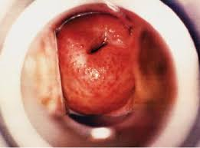

Slide 18
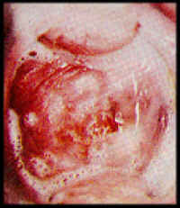

Slide 19
Investigation
A fresh wet film preparation and M/C examination
Recognized by its constant motion and flagella, adherent to a squamous cell or pus cell
Culture in special media in which antibiotic has been added to inhibit other organisms (Feinberg Whittington medium)
Can be diagnosed in a smear for cytology

Slide 20
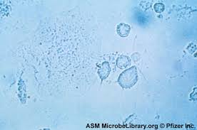

Slide 21
Treatment
Metronidazole 200 mg Tds X 7 days or 500 mg bd X 7 days for both partners, or
2 gm single dose
No intercourse or condom use during therapy
Alternatively
Tinidazole 500 mg BD for 7 days or 2 gm stat
Vaginal pessary– metron+ clotrimazole

Slide 22
Vaginal Candidiasis (Moniliasis)
Gram +ve fungus- candida albicans
Flourishes in acidic pH and abundant carbohydrate supply
Conditions which favor infection by this organism are-
Pregnancy (↑ vag acidity, glycosuria)
Diabetes (↑ glycogen, glycosuria)
Patients on antibiotics, Oral contraceptive pills, steroids, immunosuppressive therapy

Slide 23
Symptoms and Signs
Symptoms- profuse discharge, intense pruritus, soreness and edema of vulva, dyspareunia
Signs –Red, swollen vulva, excoriations
Reddened vaginal wall
Thick curdy discharge, white patches or plaques of cheesy material adherent to vagina, when removed hemorrhagic area seen

Slide 24
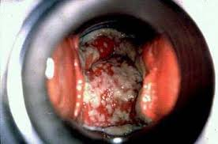

Slide 25


Slide 26
Diagnosis
Wet smear of vaginal discharge prepared by adding 10% KOH sol and M/C exam
Filamentous form of mycelia, pseudohyphae seen
Culture on Sabouraud’s or Nickerson’s media

Slide 27
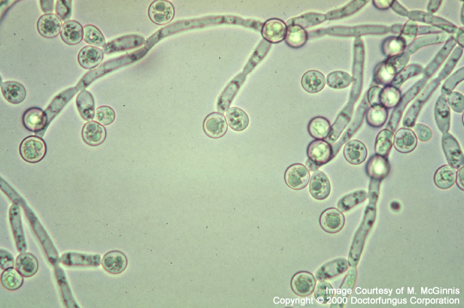

Slide 28
Treatment
Local fungicidal preparations in tablet form, or gel
Clotrimazole vag tab/pessaries X6days
Others –miconazole, Mycostatin, Nystatin vaginal pessaries 100000 units1tab hs X 14 days
Oral
Fluconazole 150 mg stat
Itraconazole

Slide 29
Treatment contd
Nails should be clipped to control source of infection
Intestinal infection suggested by perianal itching treated with oral dose, Fluconazole 50 mg for 7 days
Can repeat the dose if not relieved or
Treat partner

Slide 30
Bacterial vaginosis
Gardenerella vaginalis and organisms of other species like bacteroides, peptococcus, mobilincus, mycoplsma hominis
Gram -ve bacilli
C/O
Excessive vaginal discharge, with foul odor
Minimal or no vulval irritation

Slide 31
Diagnosis -Amsel’s criteria (4)
White homogenous vaginal discharge
Vaginal pH- alkaline (litmus paper test)
Clue cells > 20%(epithelial cells with granular cytoplasm caused by adherent bacilli)
Whiff’s test +ve- pungent odor due to release of ammonia when a drop of discharge is mixed with 10% KOH sol (OR)
HVS culture

Slide 32
Clinical implications
PROM
Preterm labor
Chorioamnionitis,
Endometritis
Recurrent infection may cause PID
PID following abortion
Vaginal cuff cellulitis following hysterectomy

Slide 33
Treatment
Metronidazole 200mg thrice daily or 500 mg BD 7 days or 2 gm stat
Secnidazole 2gm stat
Clindamycin 300 mg BD X 7 days
Clindamycin cream vaginallyX 7 days
Metronidazole cream vaginally
Treatment of the partner

Slide 34
Non-specific vaginitis
Alteration of pH towards alkalinity favors non-specific infections- eg puerperium, post abortion
Mixed pathogens in smear or culture – staph, streptococcus and anaerobes, E coli
Chemicals/ drugs/douches/tampons/foreign bodies

Slide 35
Symptoms /signs
Mild or severe, acute or chronic presentation
Irritation, ↑ discharge, smelly, yellowish
Burning, dysuria and frequency
Red swollen tender vagina, profuse yellowish discharge
Diagnosis by smear and culture

Slide 36
Treatment
General measures- improve general health of the patient
Local- bactericidal cream , vaginal psessaries
Antibiotic according to organism and sensitivity (oral or vaginal)
Elimination of reservoir of infection in the genital tract such as chronic cervicitis by diathermy

Slide 37
Estrogen deficiency vaginitis
Vulvo-vaginitis in children and senile vaginitis in postmenopausal women
Thin vaginal epithelium, ill protected against infection,
glycogen content is low, doderlein bacilli is thinly populated
vaginal pH is higher than normal – 7.4 or more

Slide 38
Senile (Atrophic) vaginitis
Vagina is inflamed sore edematous, excoriation of skin, purulent or blood tinged discharge, frequency and dysuria
Vagina is patchy red , bleeds on taking swab
Infection may spread upwards –endometritis

Slide 39
Management
Exclude endocervical and endometrial Ca or pyometra
Treatment
Oral estrogen
Local estrogen cream or tab

Slide 40
Vulvo-vaginitis in children
Common age group- 1st 5 years or any age before puberty
Estrogen deficiency
Foreign body
Threadworm
Non specific infections

Slide 41
Infecting organisms-
gonococcal, strepto/ staphylococcus or E coli, trichomonas or candida rare
Transmitted by infected adults/ another child by hands, clothes

Slide 42
Diagnosis by symptoms and signs, EUA, swab culture
Treatment-
Perineal hygiene
Estrogen cream
Antibiotic if culture +ve

Slide 43
SUMMARY
Vaginal discharge – differentiate B/W normal and abnormal by
Symptoms/Signs- specific to organisms, investigations if want to confirm , otherwise treat the cause
Nonspecific vaginitis – cause according to S/S, age group, treat accordingly

